Slide 1


Intelligence Augmentation (IA) for AI Hackathon
Final Submission
Team : AINE
Members : Shanmukha Sainath, 3rd yr E&ECE, IIT Kharagpur

Slide 2
Index
S.No | Pages | Content
1 | 3 | Folder Structure
2 | 4 | Problem Statement
3 | 6 - 11 | Machine Learning Model
4 | 12 | Application
5 | 13 | Snapshots of Application
6 | 14 | Future Scope

Slide 3
Folder Structure
• site (contains files related to WebApp)
• code (code files)
➢ mp32wav.py : to convert the mp3 files to wav
➢ IA for AI.ipynb : code for training and testing
• submissions (To scored submissions)
➢ submission_{score}.csv
• snapshots (screenshots of web app)
• demo.mkv : demo video of WebApp
• Cogito IA for AI finale.pdf : full details of my approach
• Instructions to Run.txt : steps to be followed to run

Slide 4
Problem Statement
Given a audio dataset, create a model that classifies the audio into given label.
Build an Application using the Machine Learning model created
Type : Multi Class classification
Data Type : Audio
Metric : Accuracy
Dataset Details :
➢ TrainAudioFiles: mp3, wav training files
➢ TestAudioFiles: mp3, wav test files
➢ train.csv: labels for training data
➢ test.csv: names of test files
➢ sample_submission.csv: submission file

Slide 5
MY APPROACH

Slide 6
Machine Learning Model
Steps:
Data Exploration
Data Preprocessing
Training

Slide 7
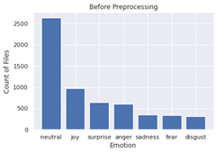
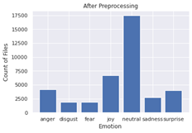
Data Exploration
Number of audio samples of respective classes

Slide 8
Data Preprocessing
First all mp3 files are converted to wav using mp32wav.py
Library used : pydub
Created embeddings for both training and test data using pre-trained audio models.
-> Libraries used: openl3, soundfile
-> Embedding size : 512
-> There are different arguments present in openl3 which I changed to obtain different embeddings.
For a given audio file embeddings are of shape (N, 512). N depends on the duration of audio.
I converted each embedding to N 512D embeddings and given same label to all those which I later used for training.

Slide 9

Example for Preprocessing
Audio
Duration : 6.5 sec
N (total number of data samples from this audio): 13
Total embeddings size : (13,512)
N : depends on hop-size in openl3 (embeddings frame rate)

Slide 10
Training
Testing
Embeddings obtained during preprocessing step are trained with KNN classifier
K Fold cross-validation with standard-scaling method is used.
Model is saved in .pkl format which is later deployed using Flask.
During testing, after obtaining embeddings from preprocessing step, probabilities are averaged over set of obtained embeddings.
Finally index with highest probability is used to predict emotion.
0 : anger , 1 : disgust, 2 : fear, 3 : joy, 4 : neutral, 5 : sadness, 6 : surprise

Slide 11
Other Experimentation
Different pretrained models like VGGish, edgel3, openl3 are used to obtain different sized embeddings.
Different scaling methods like min-max scaler, standard scaler are used to preprocess embeddings.
Hyperparameter tuning is done for KNN classifier for parameters k_neighbours, weights.
CNNs are used to train STFT of the audio files given, but didn’t give better results.
FLAML is also used to experiment various boosting techniques like Random Forest, LGBM, Cat Boost, XGBoost.

Slide 12
Application
Tech stack used : HTML, CSS, JavaScript (Frontend), Flask (Backend)
Instructions for installation and running application are in Instructions to Run.txt
There are mainly 4 sections app
1 : Upload (center)
2 : Audio Display (right)
3 : Prediction Display (top-left)
4 : Probabilities Display (bottom-left)
Click on Upload image to upload audio. Play audio to see display in “Audio Display” section
Click on “Check Prediction” to obtain the predicted emotion and respective probabilities

Slide 13
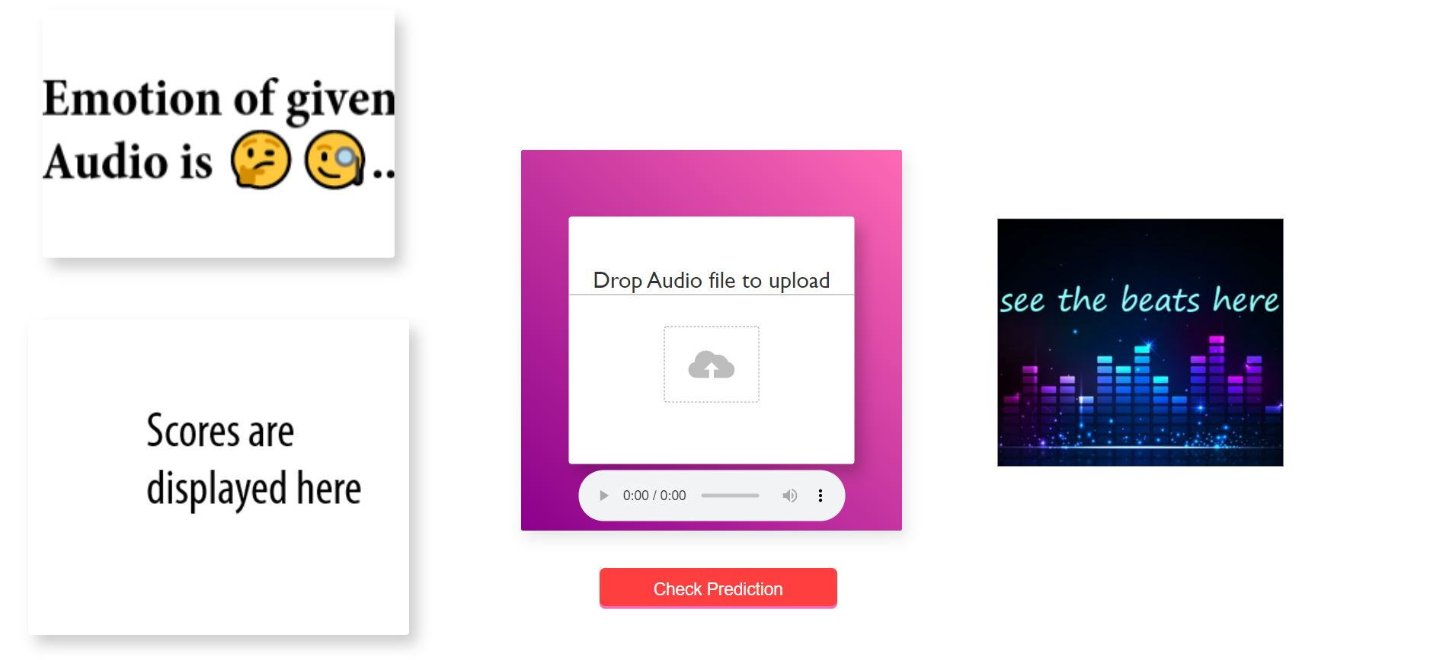
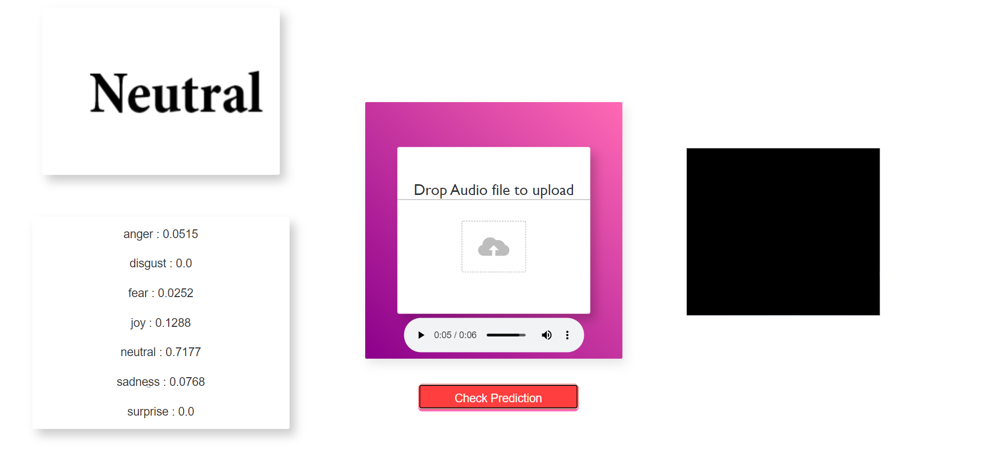
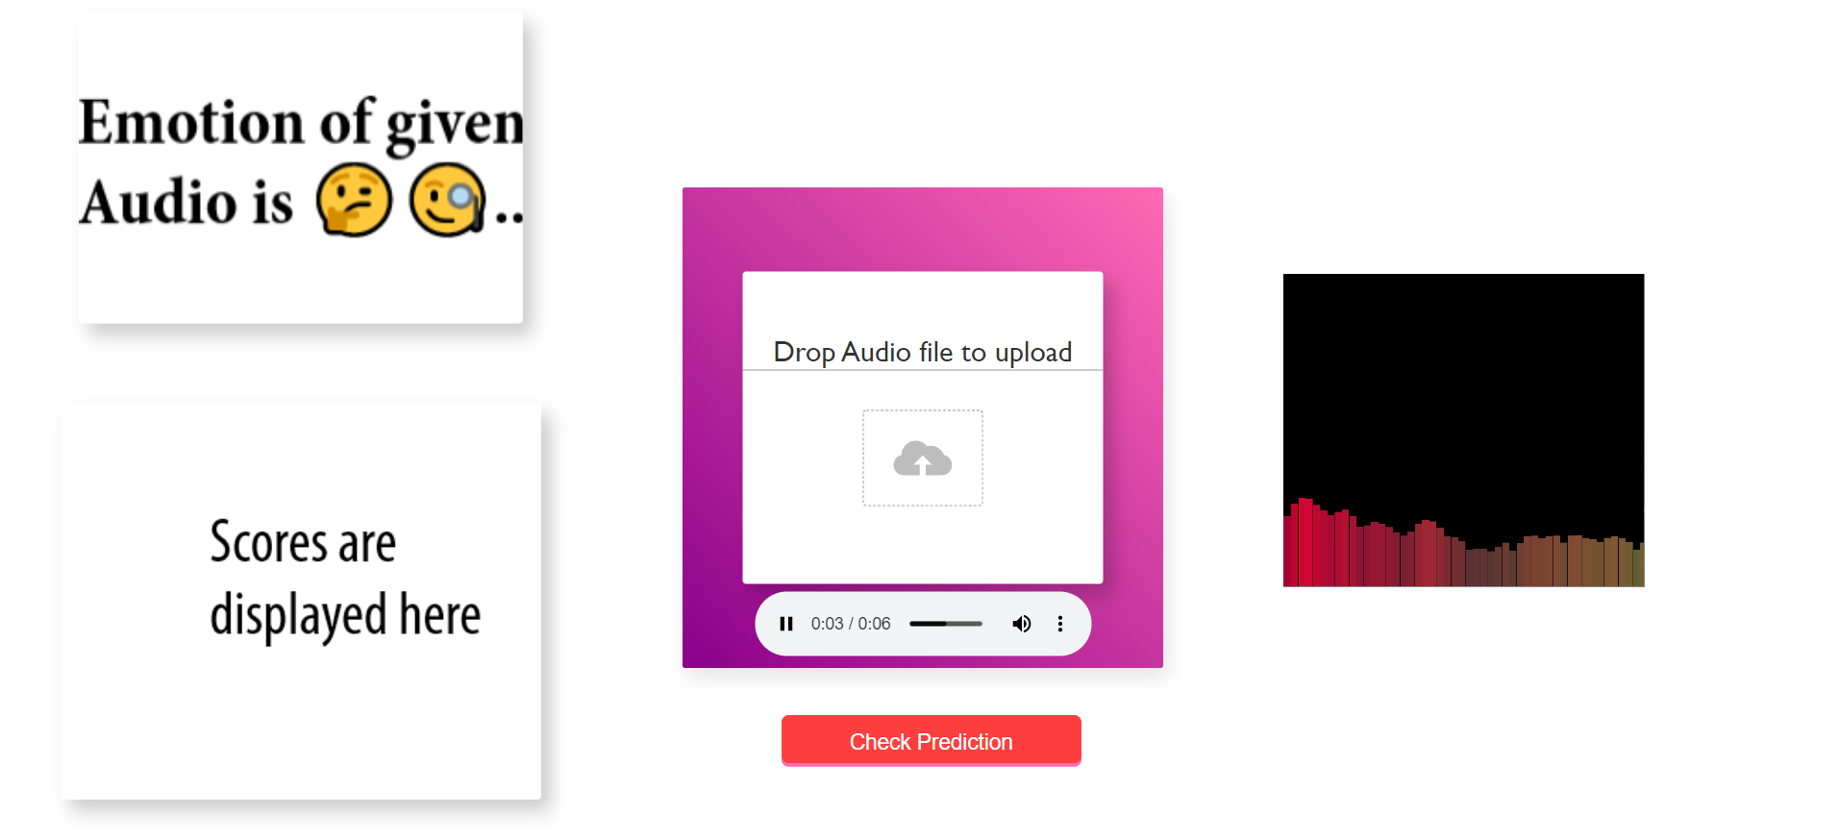
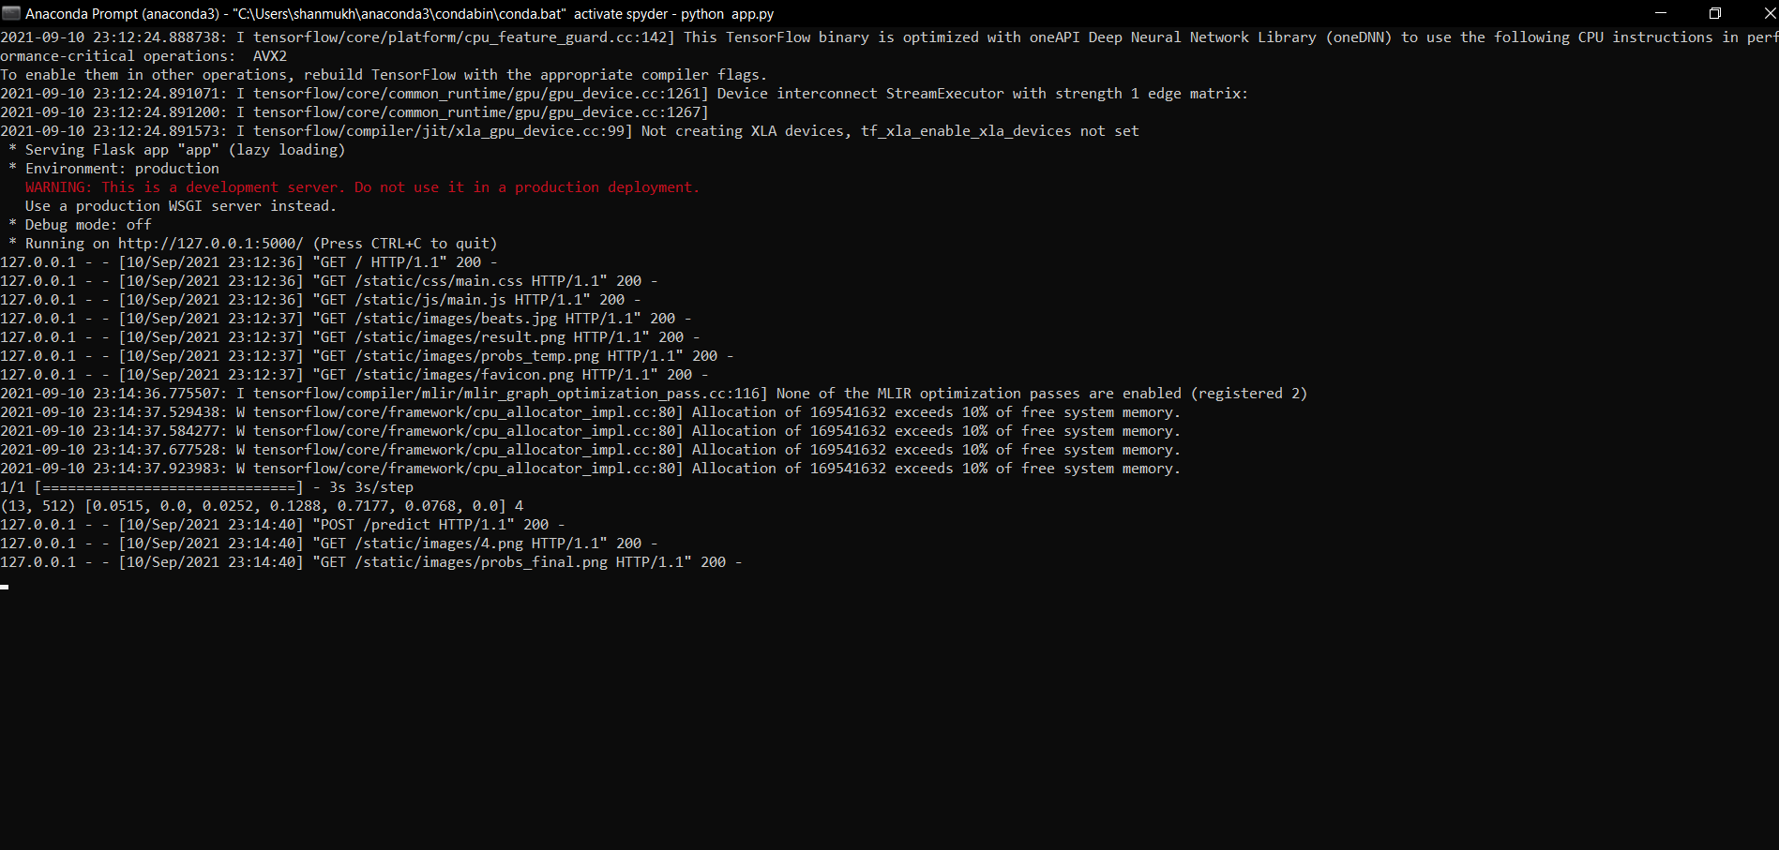
Snapshots

Slide 14
Future Scope
Model size can be optimized as well as speed using GPU and RAPIDS library.
A recording audio option can be added to WebApp through which we can directly predict the emotion by recording real time audio.
External Public datasets can be used to increase score of best models.
Recurrent Neural Networks like LSTM, GRU can also be used to train audio data.

Slide 15


